Slide 1
A Review on Principal Component Analysis
Chris Kuo, Ph.D.| Columbia University

Slide 2
A linear orthogonal transformation
PCA is a linear orthogonal transformation that transforms the data to a new coordinate system
The greatest variance by any projection of the data will lie on the first coordinate (called the first principal component), the second greatest variance on the second coordinate, and so on.

Slide 3
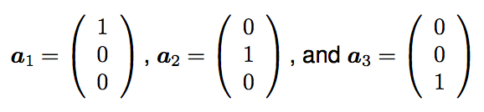



Coordinate systems
The vectors $a_{i}$have a special interpretation as a coordinate system or basis for a multidimensional space.
This basis is orthogonal, because $a_{i}$· $a_{j}$ = 0 for all i and j such that i $≠$ j.
The basis vectors allow y to be written as
$y= a_{1}y_{1}$+ $a_{2}y_{2}$+ $a_{3}y_{3}$

Slide 4


Coordinate transform, or change of basis
Re-map the data into a new basis
$$x^{∗}=Ax$$
Here A defines our new basis. We can always convert back to the original basis via:
$$x=A^{−1}x^{∗}$$

Slide 5
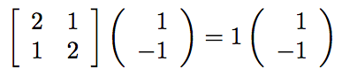


Eigenvectors, Eigenvalues
For any matrix $W$ there are special vectors $v$ such that: $Wv=\text{λ}v,$ where is $\text{λ}$ rescaled by a constant λ. The direction of $v$ is not changed.
The vectors v are known as eigenvectors, and the associated scalars λ are known as eigenvalues.
$Wv=\text{λ}v,$

Slide 6
PCA
Rotate the data so that the directions of maximum variation lie along the axes
Compress the data by throwing out directions associated with small eigenvalues
The eigenvectors of the covariance matrix correspond to the directions of maximum variance in the data
The corresponding eigenvalues indicate the amount of variance

Slide 7
Another example
Var 3
Var 2
Var 1

Slide 8
